Slide 1


(RentNinja)
RENT & HOUSING PLATFORM

Slide 2

CONTENT
01
ITERATION_1 OVERVIEW
02
SOFTWARE ARCHITECTURE
03
BACKEND ARCHITECTURE
04
FRONTEND ARCHITECTURE
05
FEATURES DISPLAY
06
NEXT STEPS

Slide 3
Iteration 1 Overview
Refine requirements
Core Infrastructure and architecture design
Set up configuration environment for frontend(Vue), backend(Java-AWS Lambda), database(AWS DynamoDB),Git, CI/CD Pipeline, Docker etc..
Implement All Essential Features(user login, sign up, user post, rental detail, rental list, user search, rental Filters)
Complete part of the Essential Features testing (API Testing, UI Testing)
Set up Jira Project management process and Complete User Stories

Slide 4
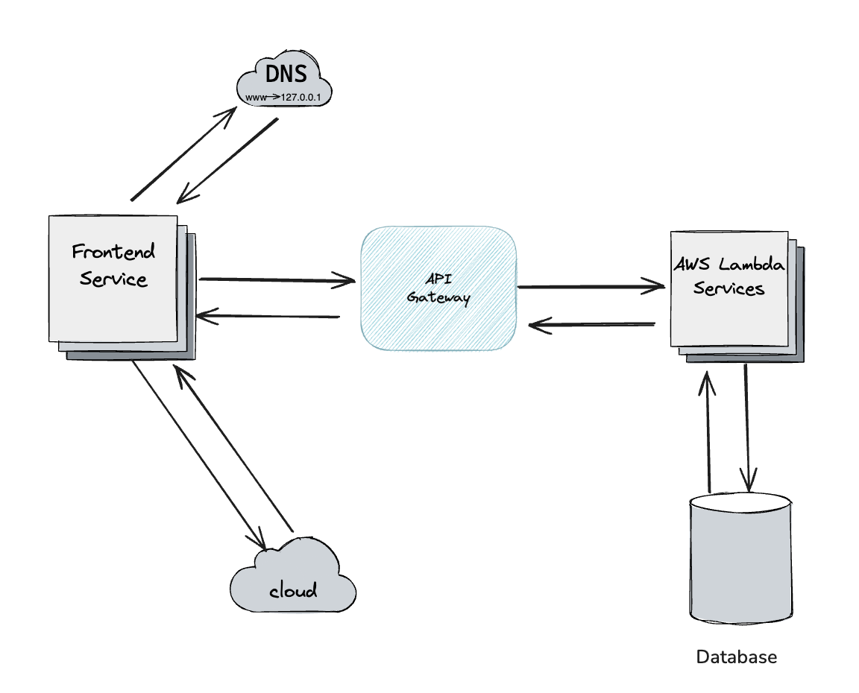
Software Architecture

Slide 5
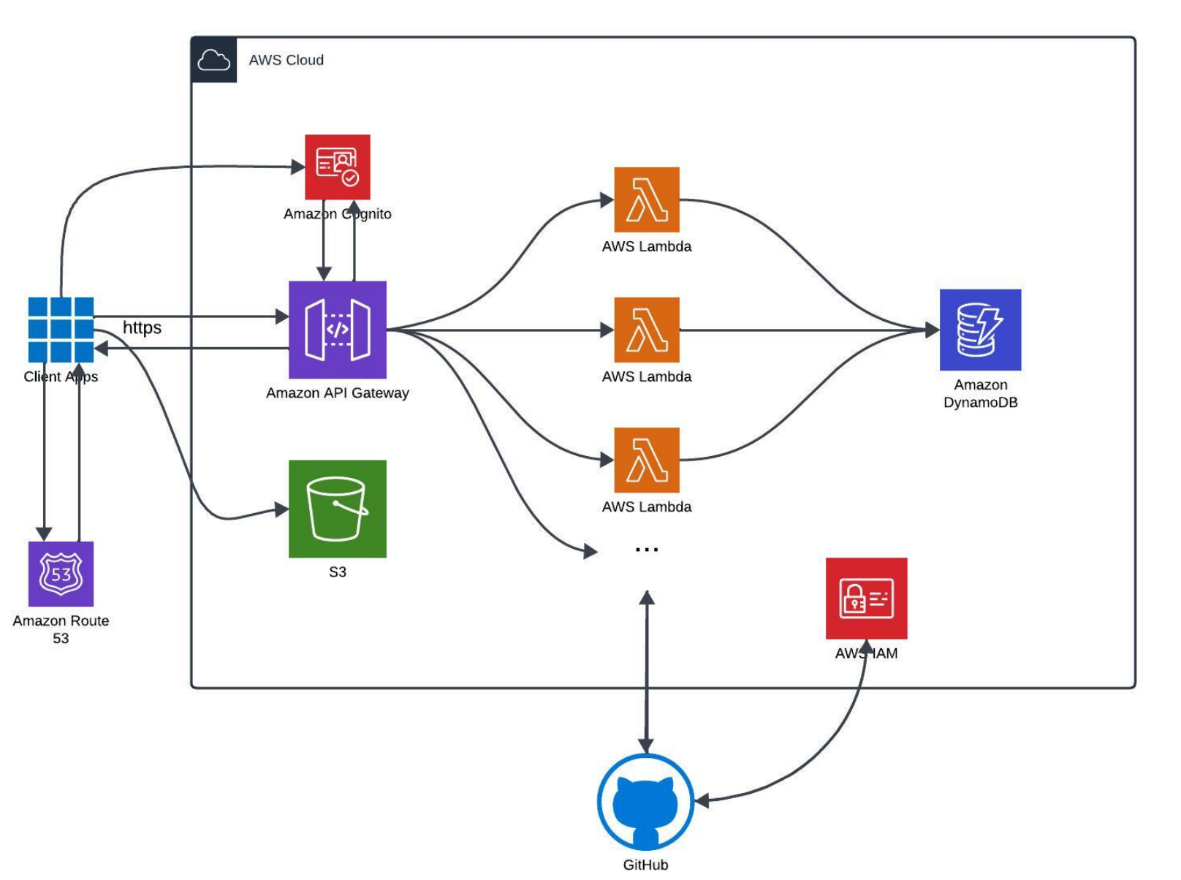
Backend Architecture

Slide 6
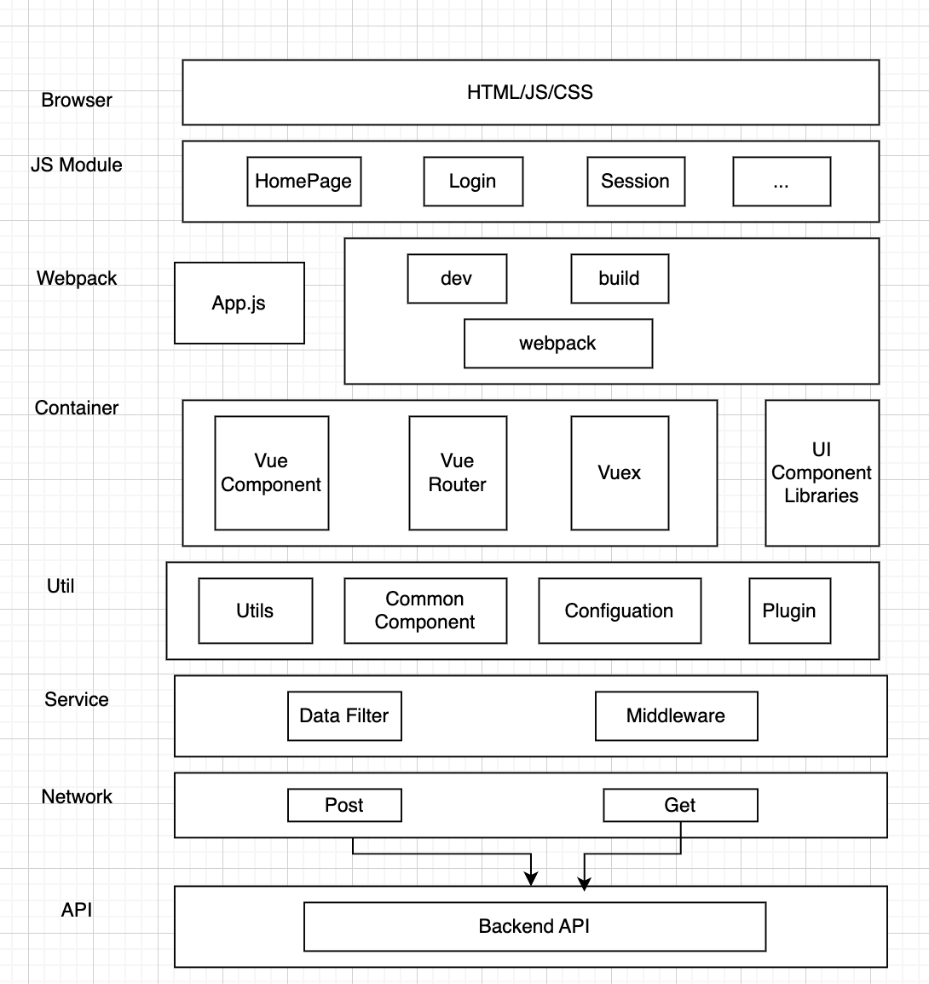
Frontend Architecture

Slide 7
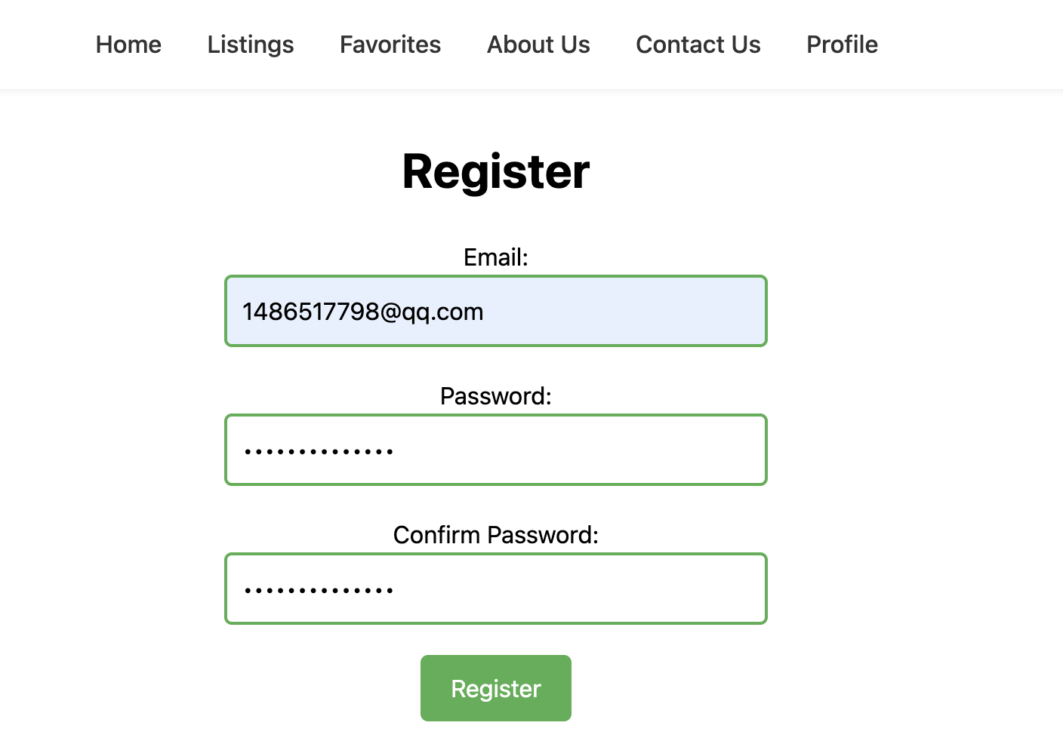
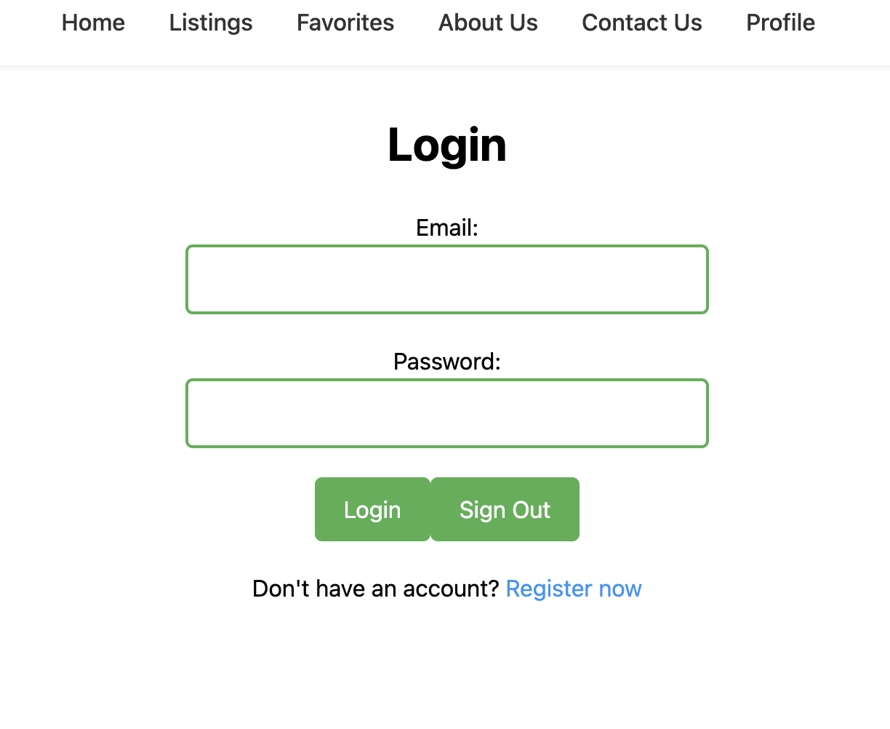
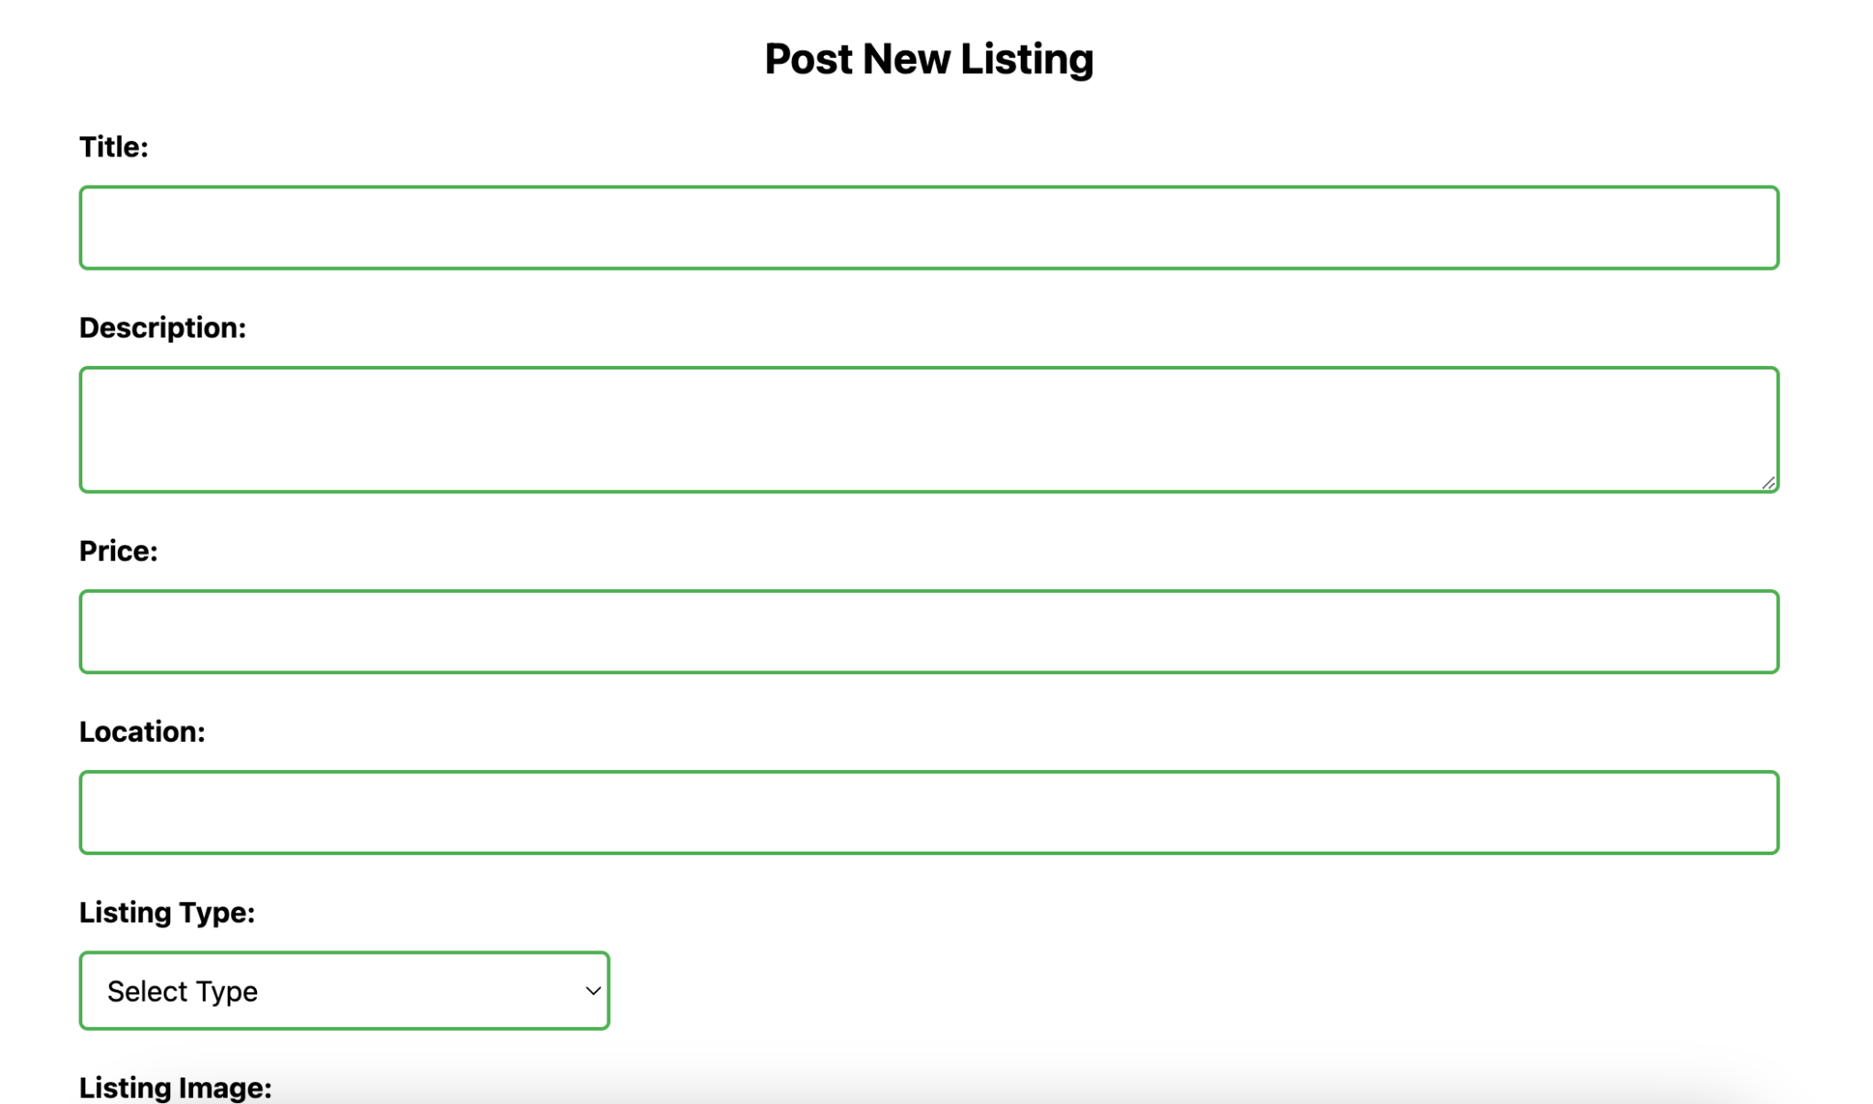
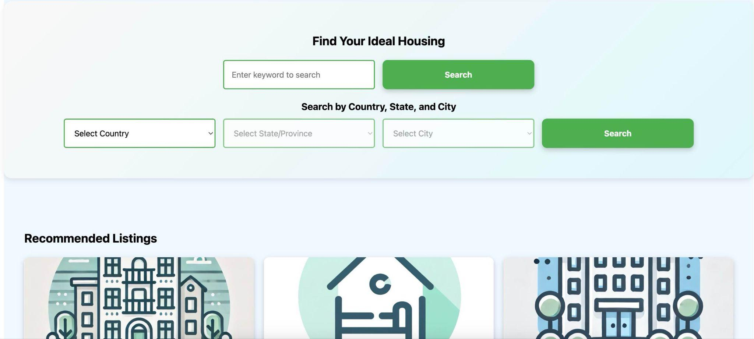
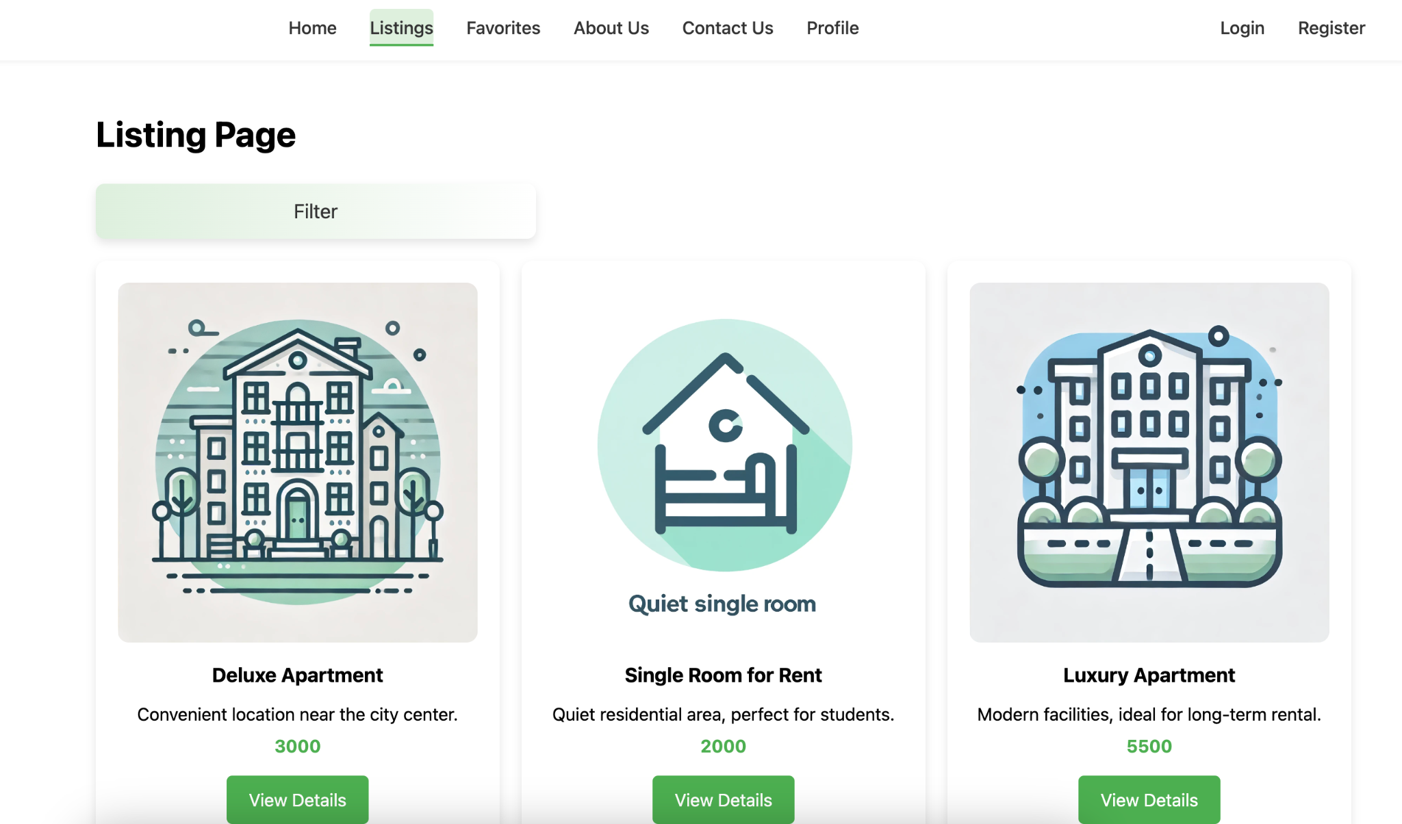
Features Display

Slide 8
Next Steps
Implement The Disearable Functional Features(User Collection Functionality, User Posted History List..)
Complete All the Essential Features QA Testing (Integration Testing, System Testing, Unit Testing)
Complete All Essential Features Security Testing
Problem-Solving & Bugs Fixing
Complete Disearable Functional Features API Testing

Slide 9

THANKS FOR WATCHING

